Slide 1
WORKSHOP
CSS
The Basic of Cascading Style Sheets

Slide 2
Rules
Man are curious by nature, when he face with things he yet understand, he should asketh.
Man who laugh at another's question, implying he who laugh fail to understand he too, once do not understand it.
Every man that hath attained to the use of reason, is supposed to know, he ought not to do to another, what he would not have done to himselfe

Slide 3
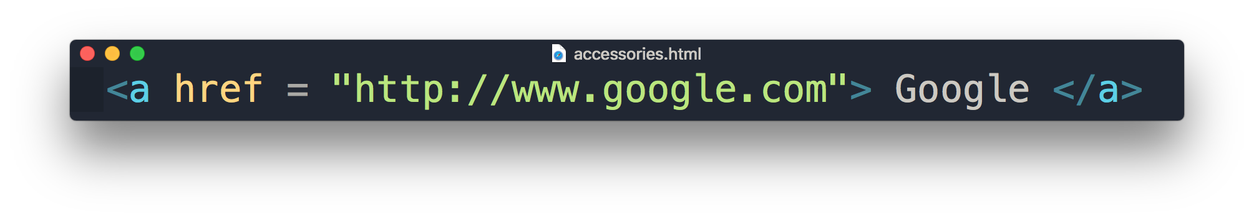
Recap HTML
Attribute
Content
Element

Slide 4
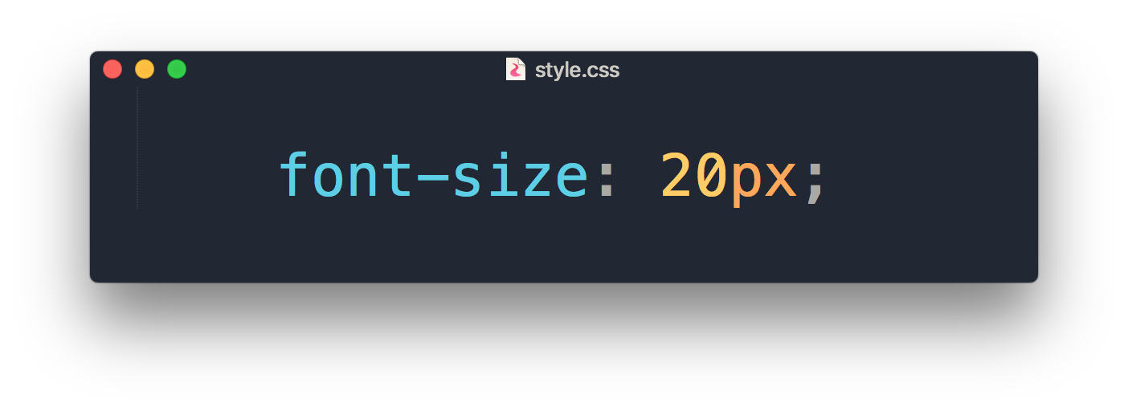
What is CSS?
Add styles like font, color, spacing
A totally different language to HTML

Slide 5
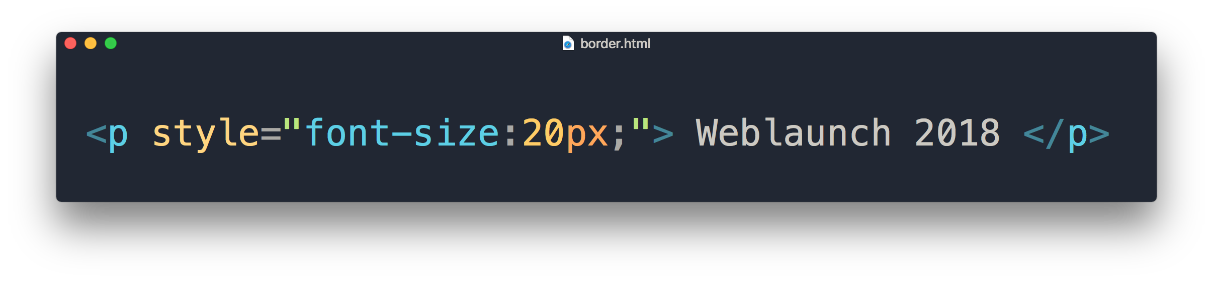
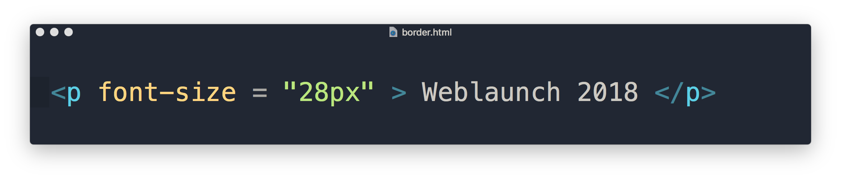
Why not just set it as an attribute?
property
value
style attribute in HTML
Inline Style Sheet

Slide 6
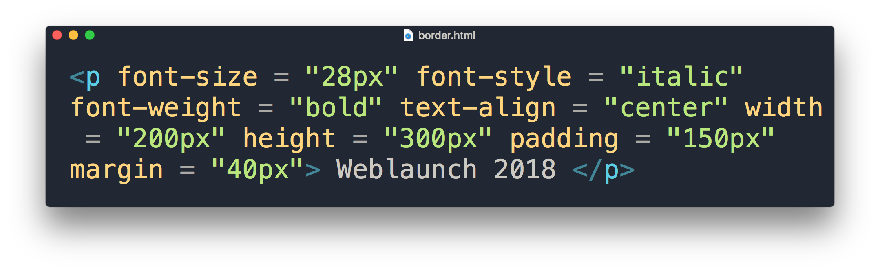
It will look like a mess

Slide 7
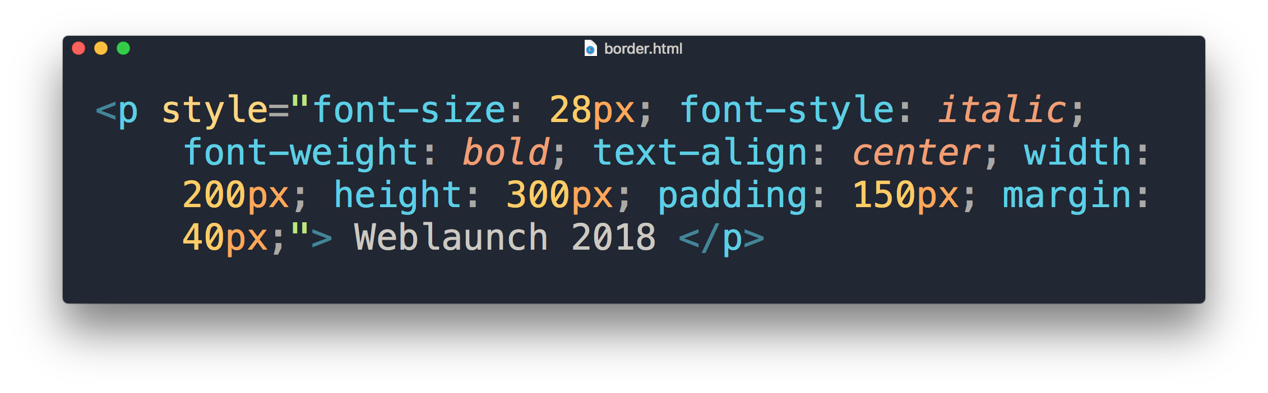
But inline would look like a mess too, right?

Slide 8
Types of CSS
Inline Style
Embedded Style
External Style

Slide 9
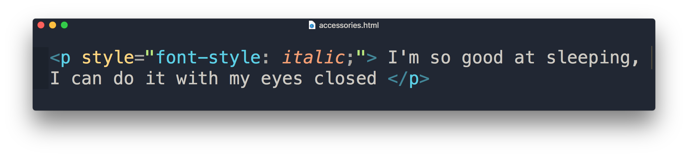
Inline Style Sheet
HTML style attribute
Only applies to specific element
Placed in <body> section

Slide 10
“What if I want it to apply to all <p> element in the rest of the page? "

Slide 11
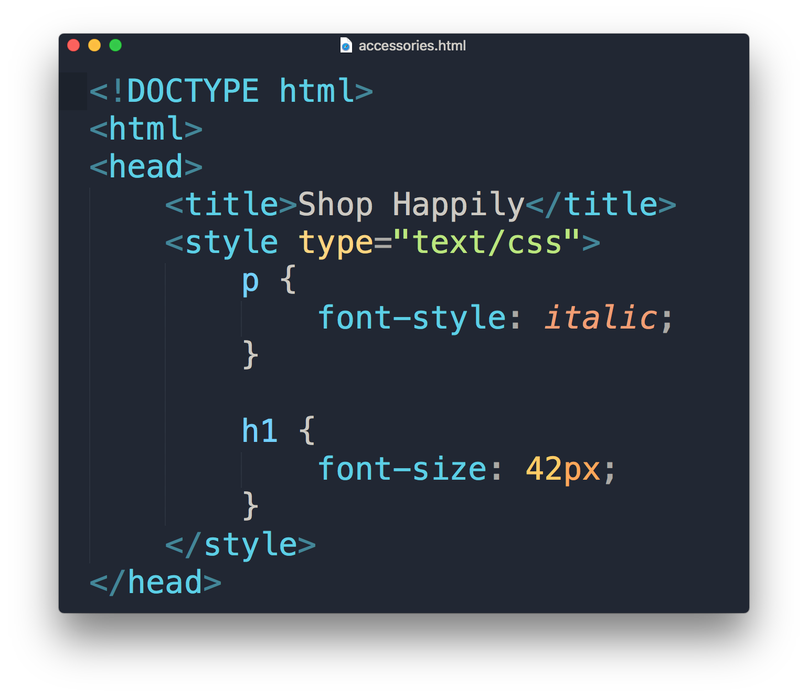
Embedded Style Sheet
HTML <style> element
Placed in <head> section
Requires selector
Only applies to a single HTML page document

Slide 12
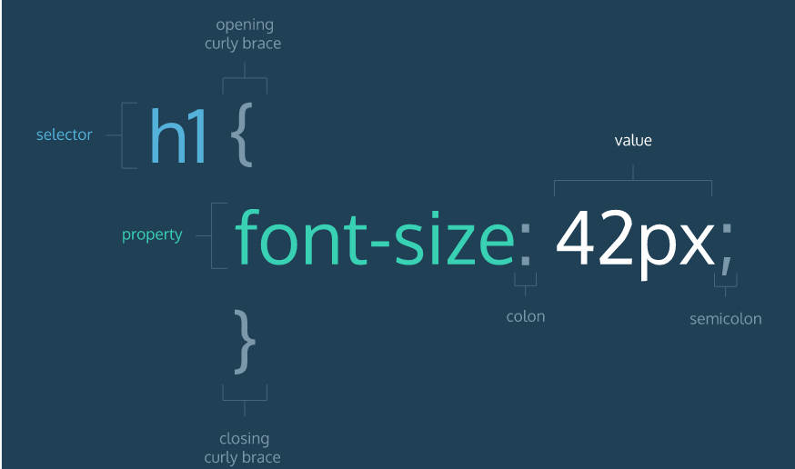
CSS format

Slide 13
“What if I want to apply the same font-size in more than one html page? "

Slide 14
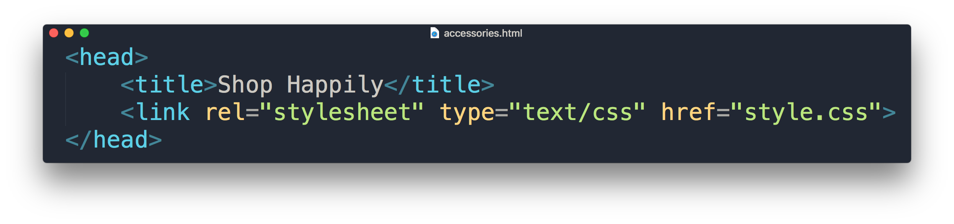
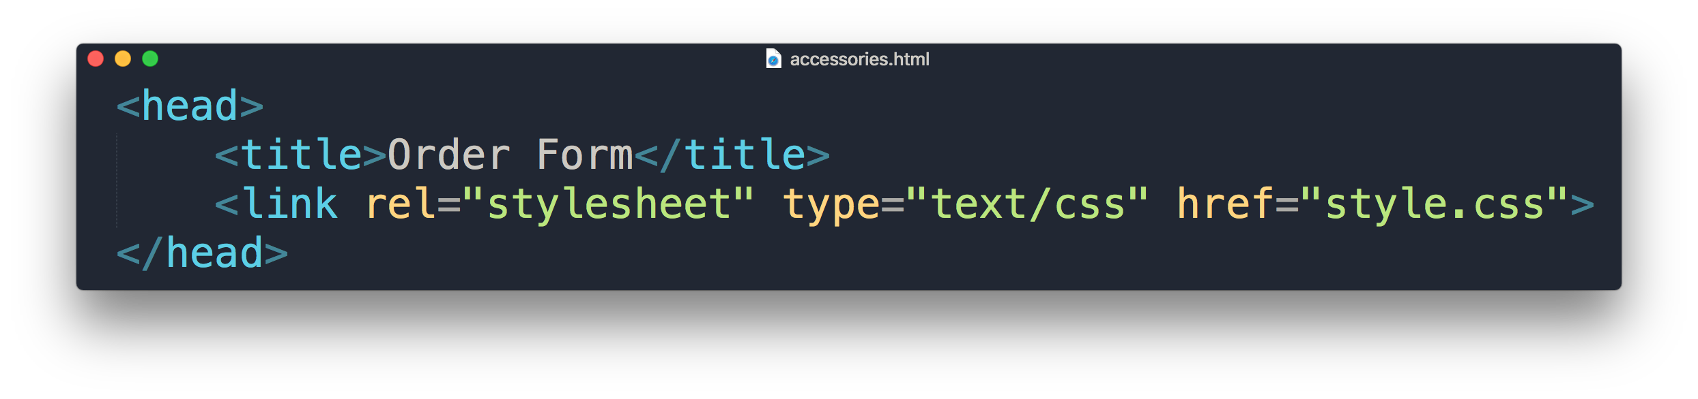
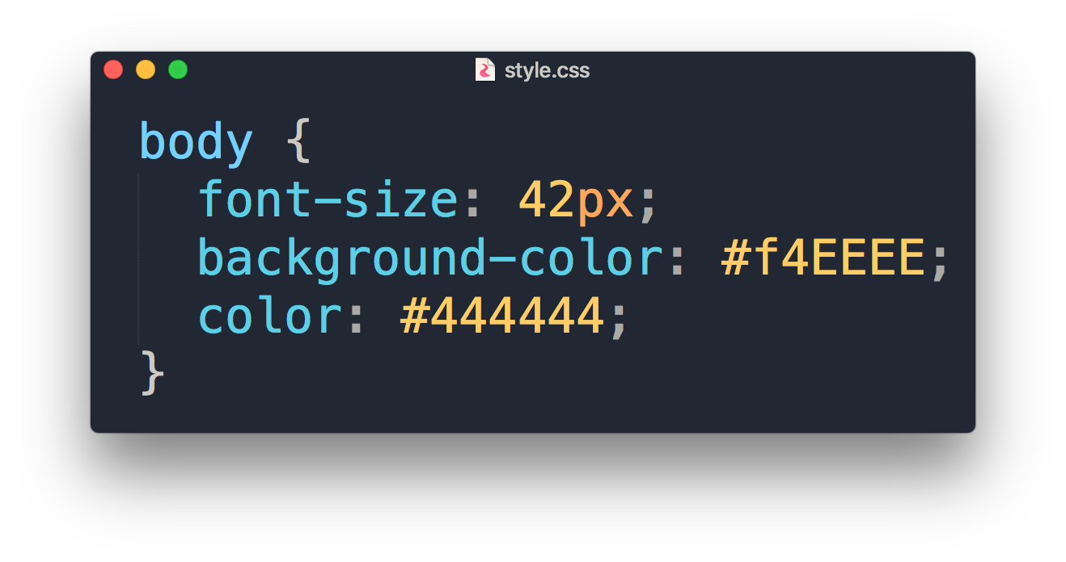
External Style Sheet
Separate HTML & CSS
Placed in <head> section
HTML <link> element to associate with .css file
Requires selector
Applies to multiple HTML page documents
What are these?

Slide 15
Hexadecimal Colors

Slide 16
Comparing Hex with RGB
Hexadecimals counts from 0 ~ 9 then A ~ F
RGB(255,0,0) = #FF0000
RGB(0,255,0) = #00FF00
RGB(0,0,255) = #0000FF
See the pattern?
Red
Green
Blue

Slide 17
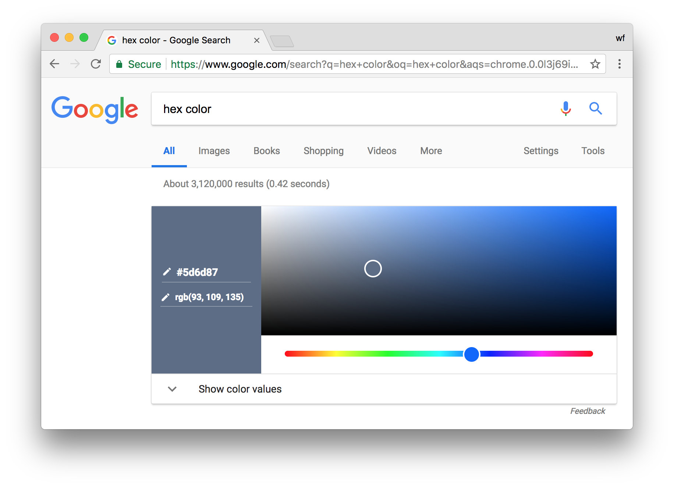
Google ‘hex color'

Slide 18

Right click > Inspect

Slide 19
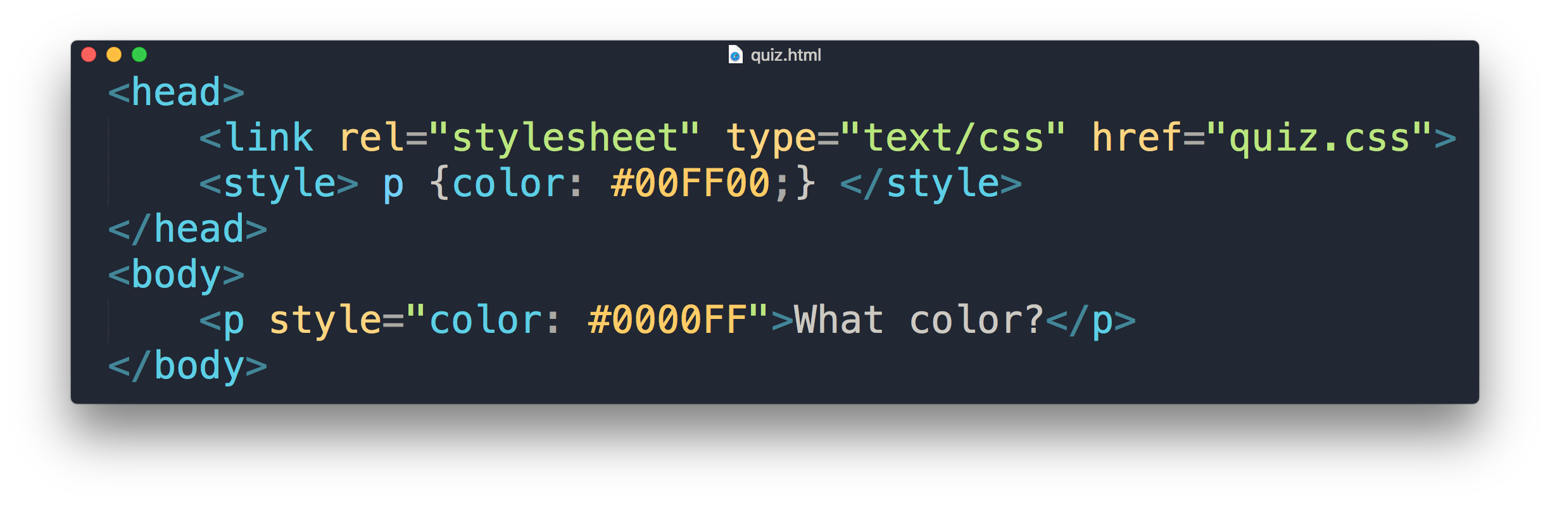
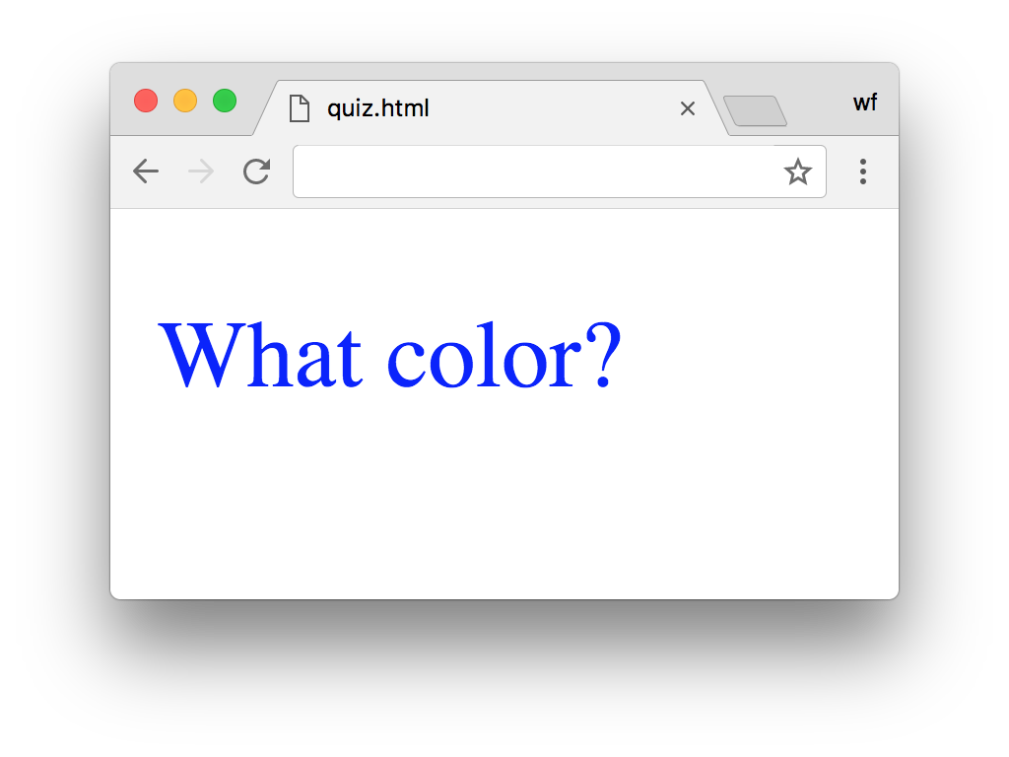
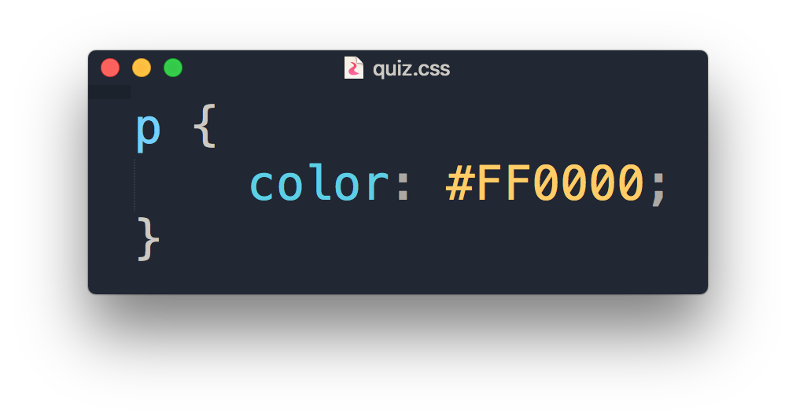
Quiz
What is the color of the output?

Slide 20
“What if I want to apply different font-sizes in two different <p> elements with external style? “

Slide 21
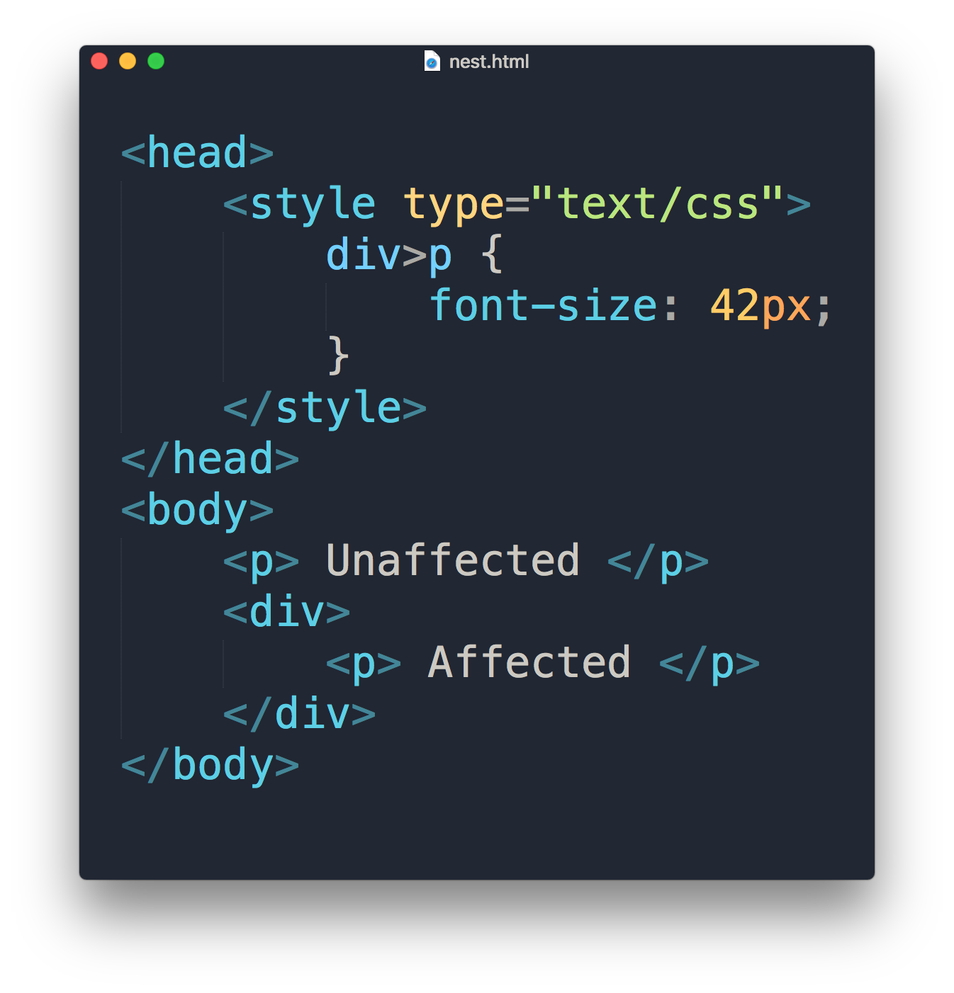


Slide 22
Selectors
div > p
div p
div, p
div *
a:link
a:hover
a:visited
All <p> one level deep in <div>
All <p> inside <div>
All <p> tags and <div> tags
All tags inside <div>
Link in normal state
Link with mouse over it
Link in visited state

Slide 23
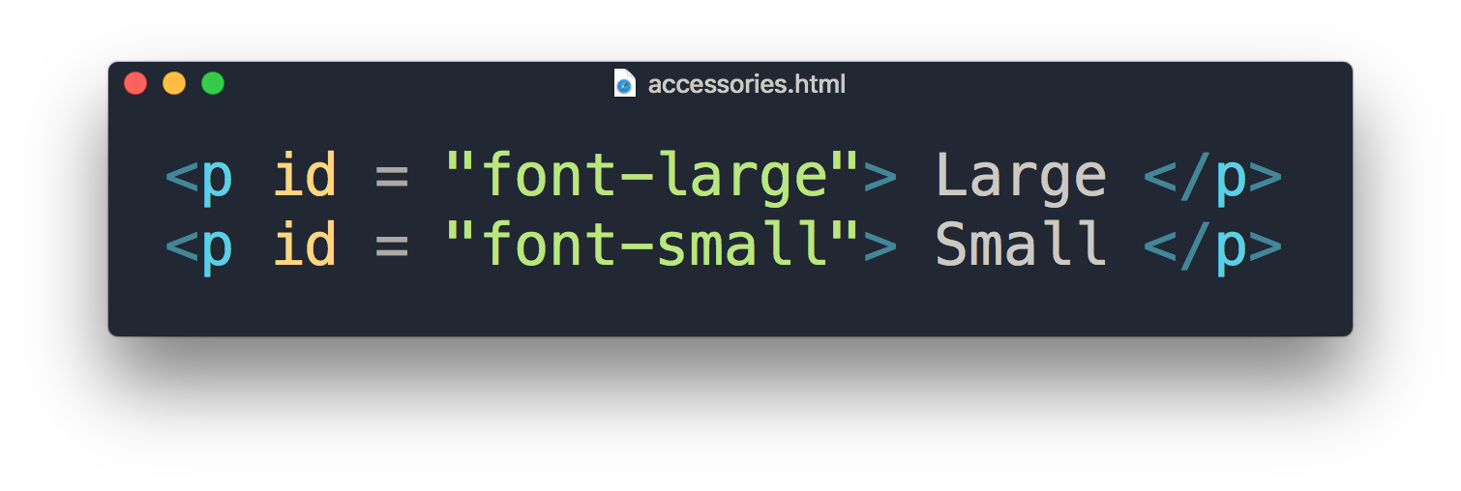
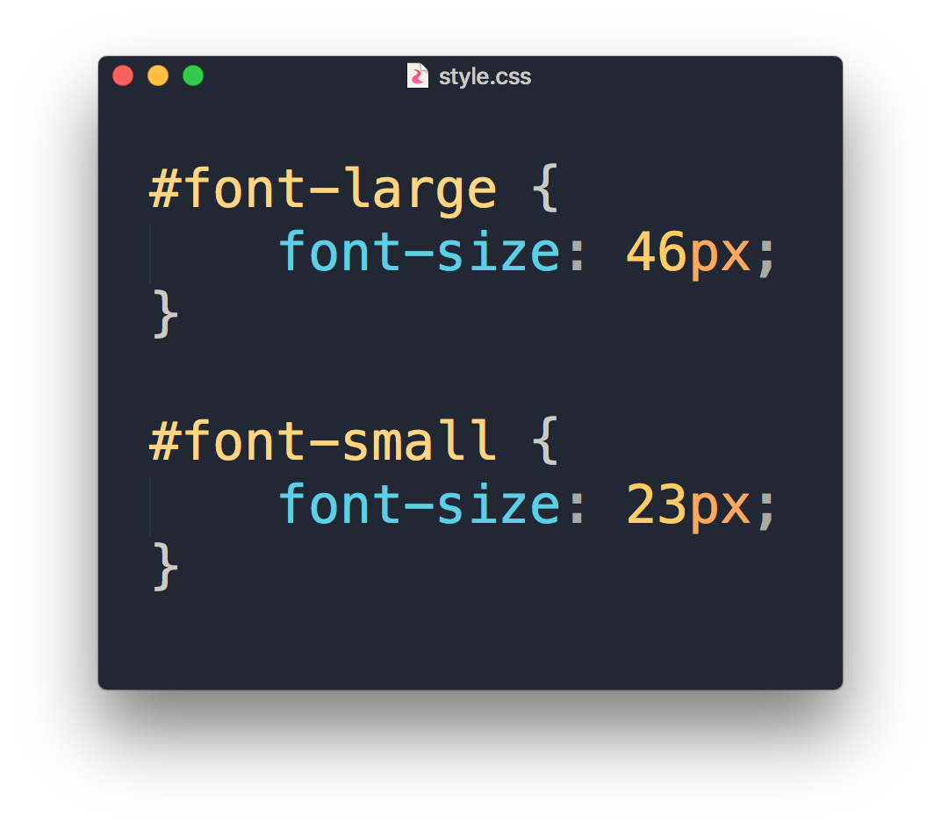
ID

Slide 24
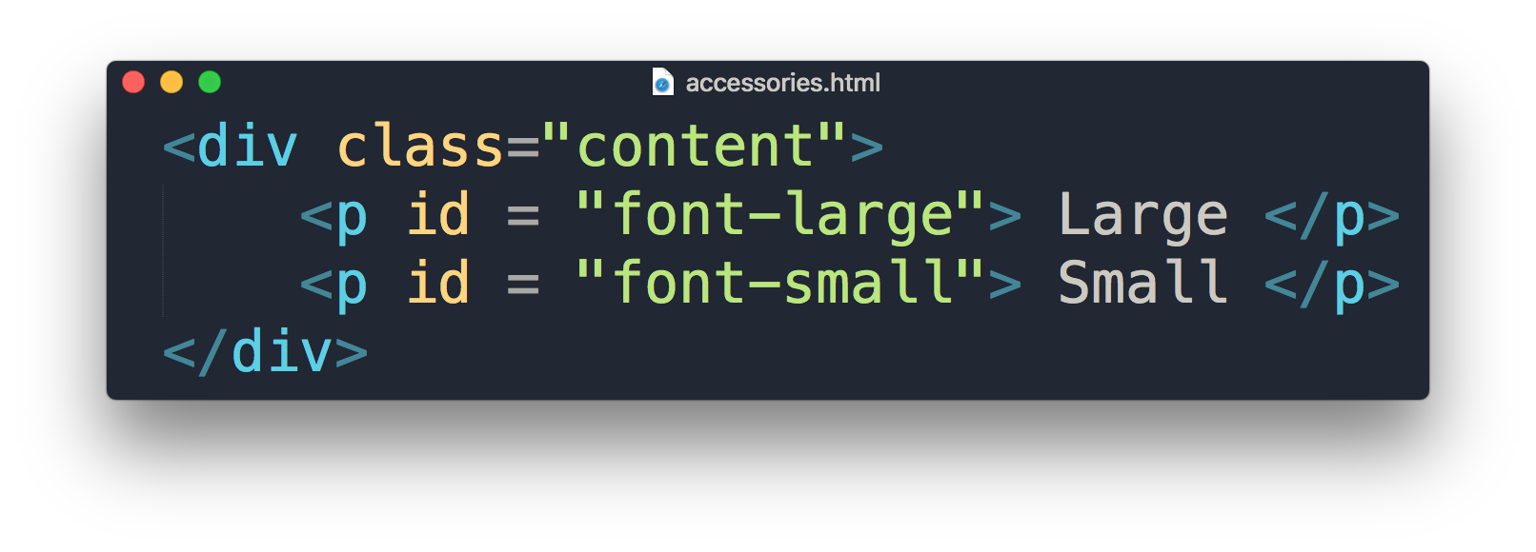
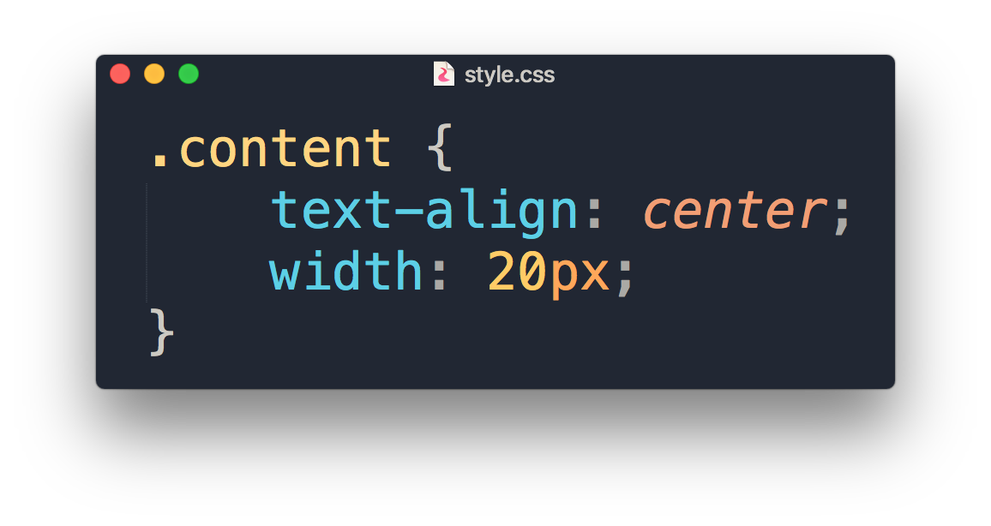
Class

Slide 25
.class
Can use same class on multiple elements.
Can use multiple classes on the same element.
To consistently style different elements.
#id
Can only be used on one element.
Each element can only have one ID.
To style single unique element.

Slide 26
COMMONLY USED CSS

Slide 27
COMMONLY USED CSS
Text and fonts
font-size
font-weight
font-family
text-align
text-decoration
The Box Model
padding
margin
border
border-radius
Visual Formatting
width
height
display
Colors and Background
background-color
color
box-shadow

Slide 28
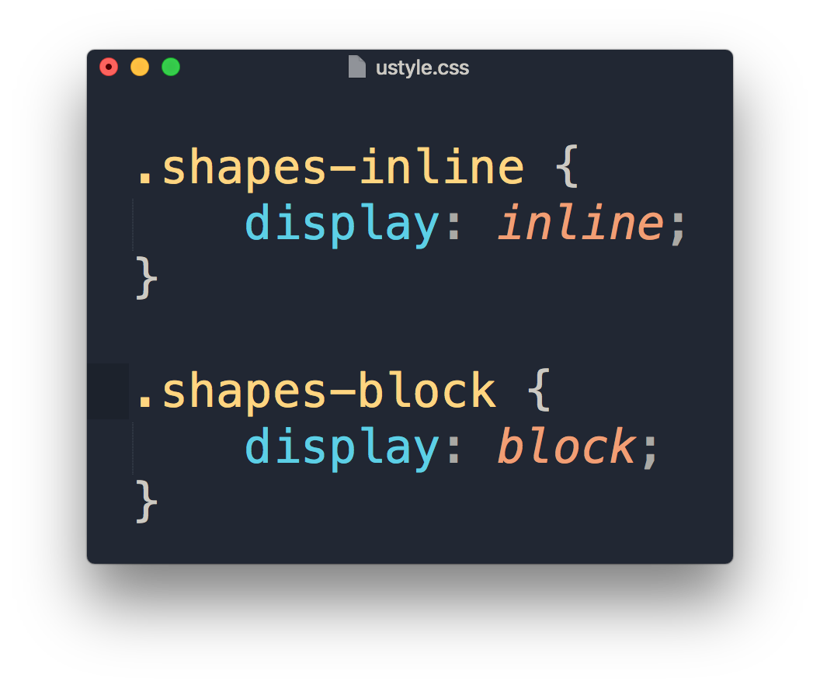
Display property
1
2
1
2

Slide 29
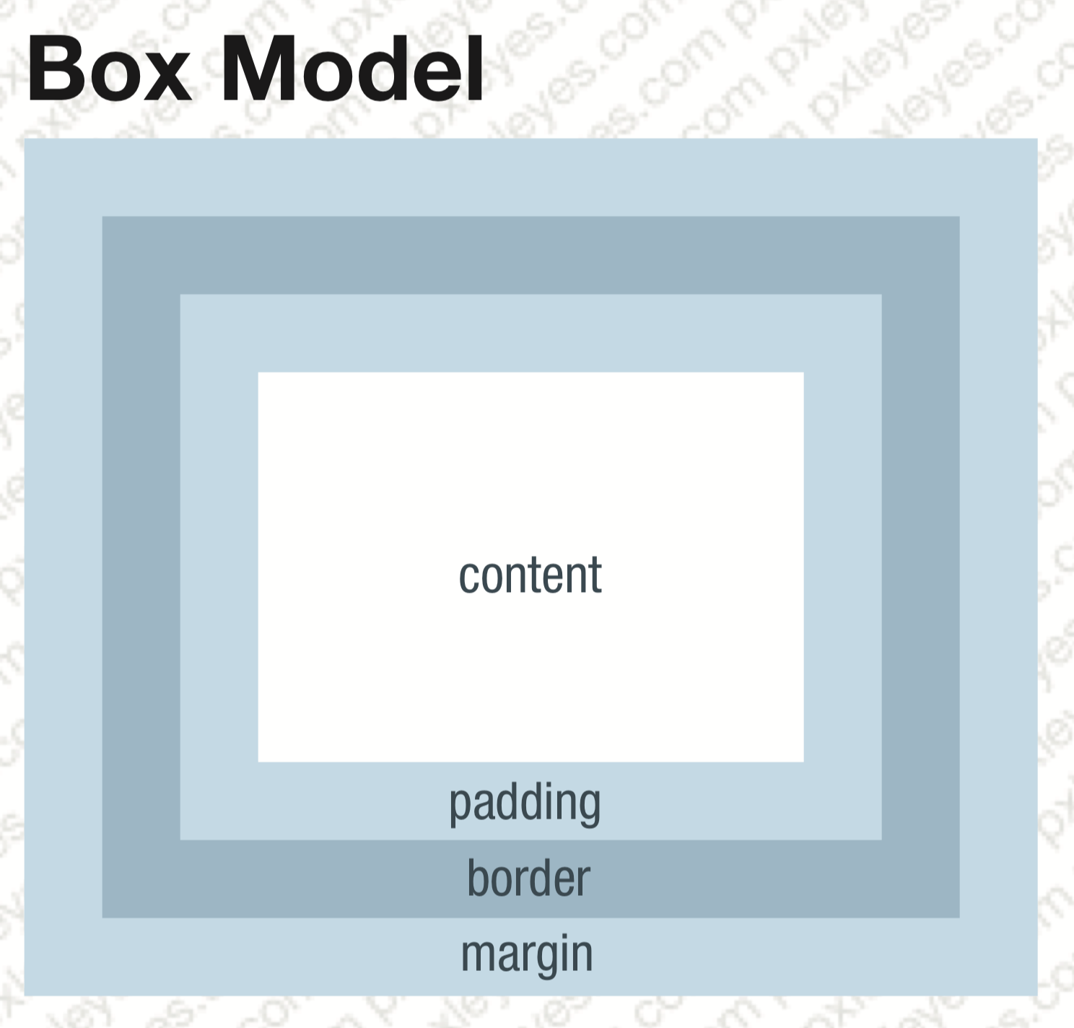
Margin & Padding

Slide 30
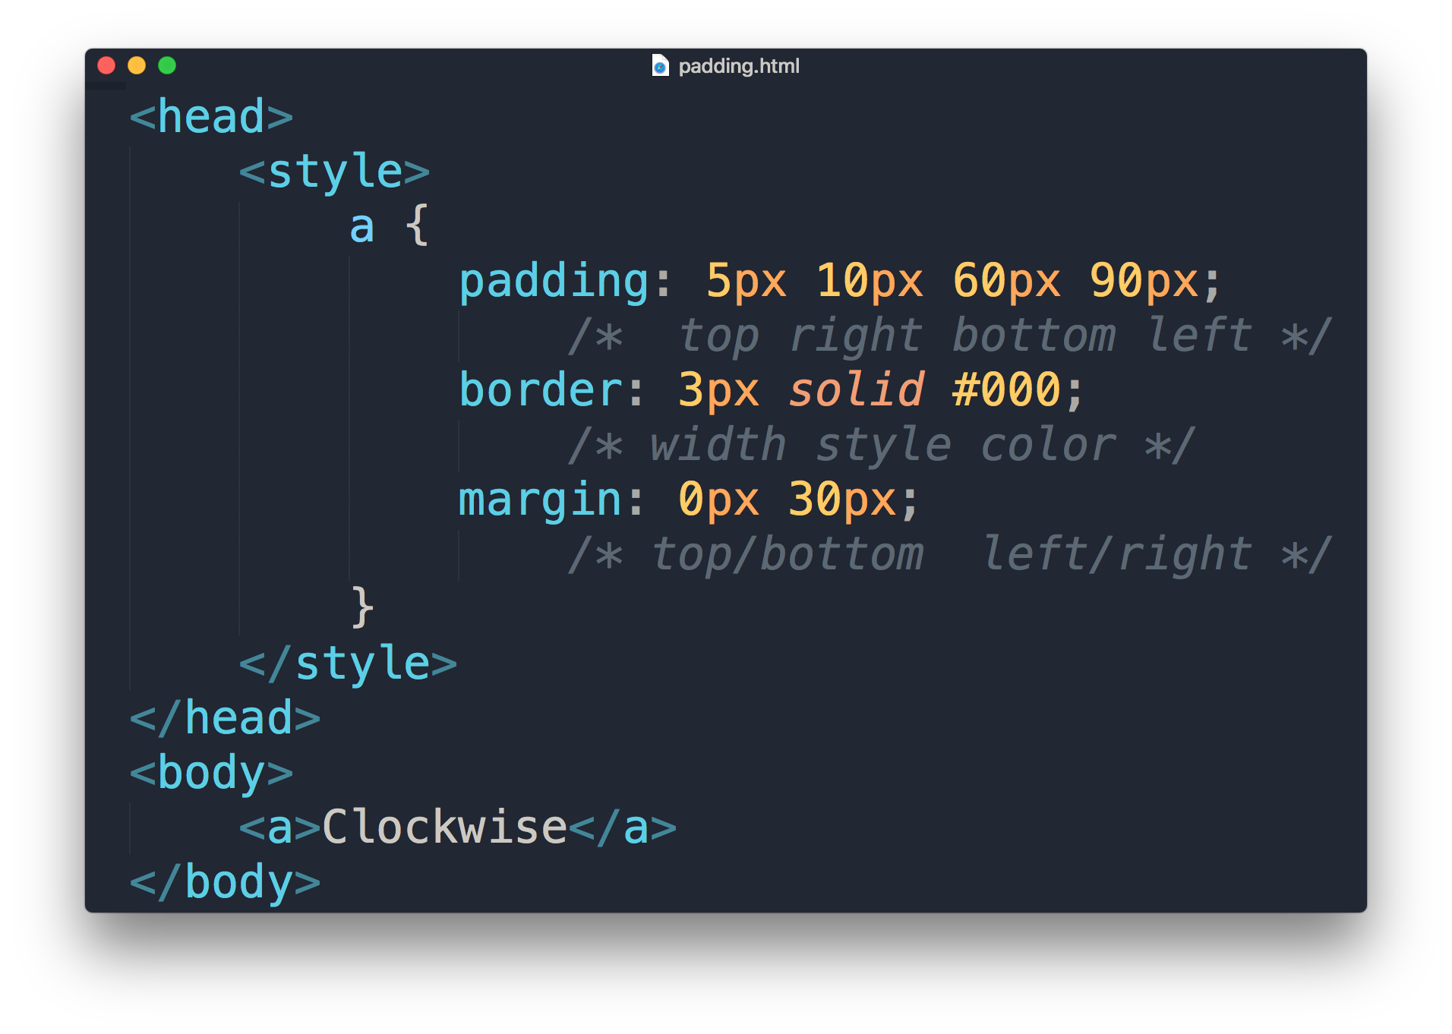
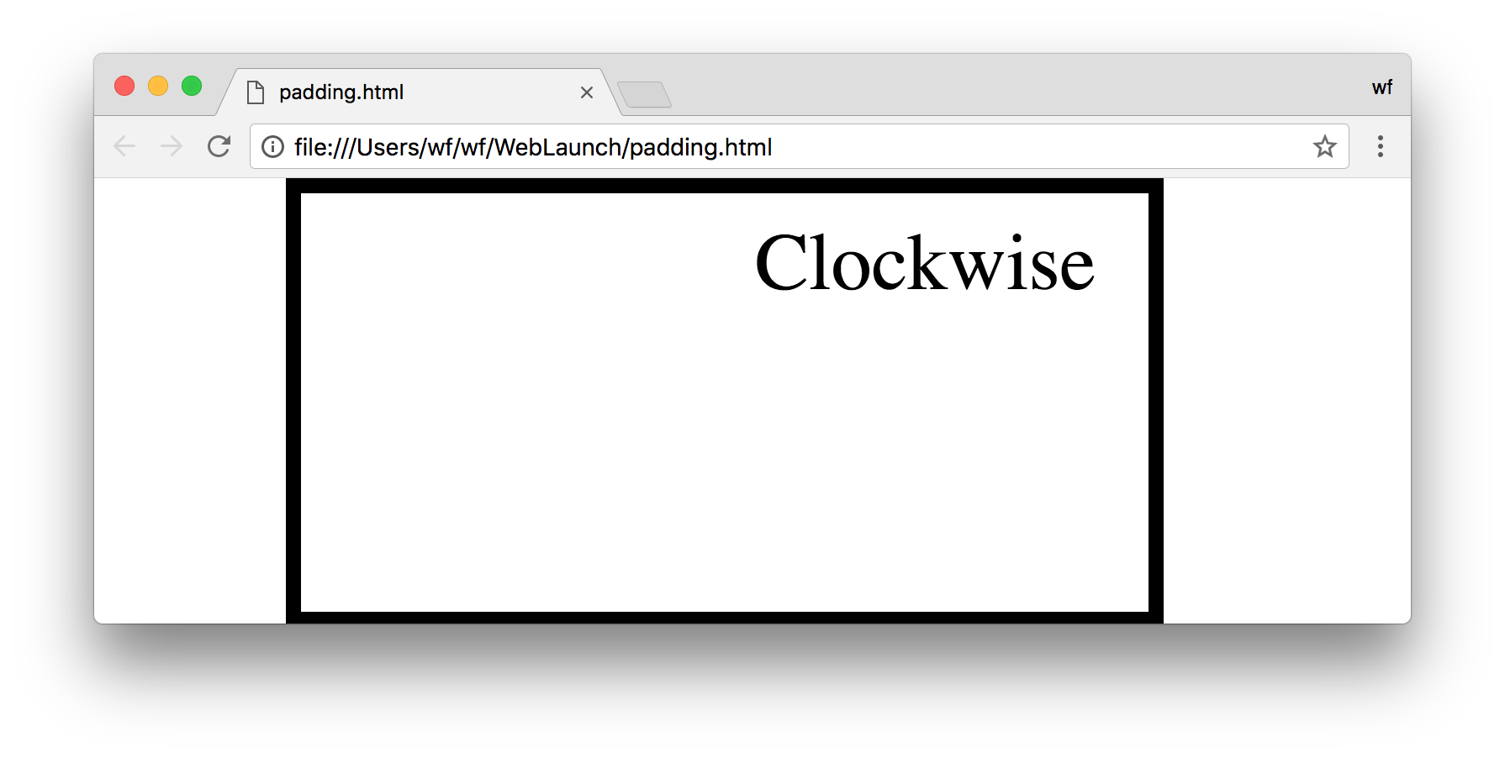
Margin & Padding
values
5px
30px
90px
30px
10px
60px

Slide 31
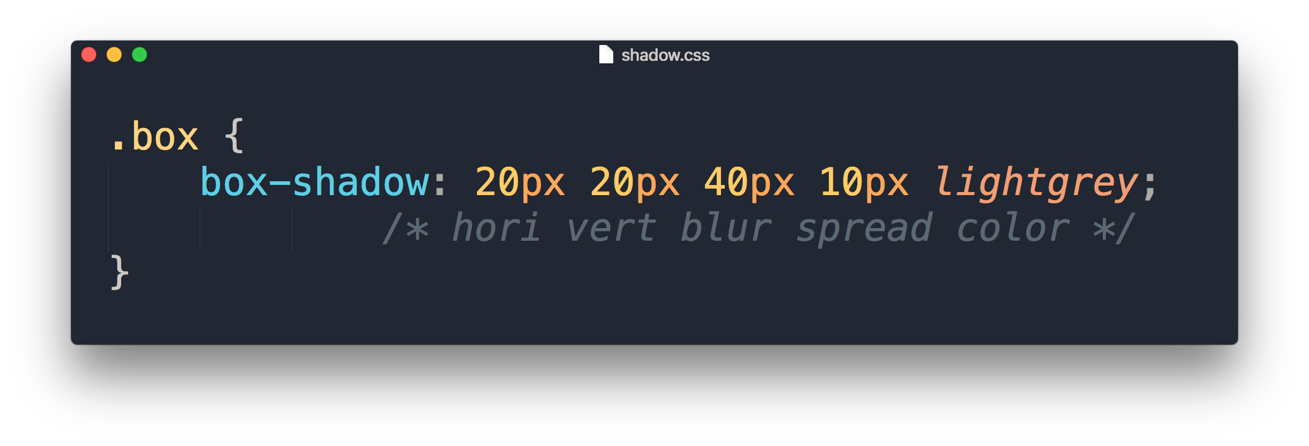
Box Shadow
values

Slide 32
Demonstration

